Slide 1
Installing Hadoop
It’s painful

Slide 2
Instructions
If you’re on Windows, then continue following these instructions
If you’re on Linux/Mac, then follow the instructions from slide 7.
READ EVERYTHING IN THIS PRESENTATION (related to your OS). We will be getting our hands dirty and these command line skills are CRUCIAL for any developer. Underlined commands are things you will need to run in the terminal. Apologies that URLs look similar to these commands…

Slide 3
WINDOWS
I tried to install natively on Windows but kept running into issues. This is an apt time to introduce you to a powerful new feature of Windows: WSL.
WSL = Windows Subsystem for Linux. It allows us to natively run Linux inside of Windows.
Installation is relatively straight forward:
Visit the Microsoft Store (Start → Microsoft Store)
Search and install “Ubuntu 20.04 LTS”
READ THE DESCRIPTION AND FOLLOW THE INSTRUCTIONS IN THERE

Slide 4
WINDOWS
Ok, you’ve got WSL installed now 👍 and have restarted your computer (because you read the Description). If you haven’t yet restarted your computer, you haven’t followed the instructions in the description… go back and try again
Run the Ubuntu app (Start → “Ubuntu”). It will take you through a user setup. Create a user. You’ll then be logged in as the user in the shell/bash/terminal.
In the Ubuntu bash, run the following:
sudo apt-get update
sudo apt-get install openjdk-8-jre
From now on, I will refer to you guys as Linux/Ubuntu users.

Slide 5
Copy and pasting on terminal
CTRL-C, CTRL-V does not work as expected on terminal
It’s easy to copy and paste though!
Copying: - To copy something FROM terminal, simply highlight it!
Pasting: - To paste something INTO terminal, simply right click!
This is the same logic as copy and pasting on Git Bash and Powershell

Slide 6
Nano
Linux/Windows users will be using nano to edit their files. Nano is a command line text editor which provides some basic functionality for editing files. If you were to run nano from the terminal, you’d see about 90% of your screen as black with some commands at the bottom of the screen. The caret symbol (^) refers to the CTRL (CMD if Mac) button on your keyboard, and the letter following the caret symbol is the letter you need to press to execute the action. This means that to exit nano, you need to use ^X (CTRL-X).
Exit nano now. Afterwards, let’s create a dummy file: nano deleteme.txt. Add “hello world!” to it, and try to exit. You’ll see the bottom change view and ask if you want to “Save modified buffer”. Press “Y” and enter, and you should have exited back to your terminal! Running ls will reveal a file called deleteme.txt :)

Slide 7
Mac
If you’re on Mac, you need to download and install Java: https://www.java.com/en/download/manual.jsp
Installation should be straightforward

Slide 8
All OS
Verify you’ve installed Java correctly by running: java -version. If you’re on Ubuntu, you should see something like the following:
openjdk version "1.8.0_265" OpenJDK Runtime Environment (build 1.8.0_265-8u265-b01-0ubuntu2~20.04-b01) OpenJDK 64-Bit Server VM (build 25.265-b01, mixed mode)
And on Mac:
java version “1.8.0_271” Java(TM) SE Runtime Environment (build 1.8.0_271-b09) Java HotSpot(TM) 64-Bit Server VM (build 25.271-b09, mixed mode)
If you’re on Mac and you see something which has “13+33” in there, the instructions following will fail. LET ME KNOW and we can resolve it together.

Slide 9
Configuring SSH
Hadoop requires SSH (if you don’t know what this is, click the link). Then, we need to make sure it is configured before continuing. Let’s generate a keypair to do so: ssh-keygen -t rsa -P ""
Now we have to enable access to the machine with the new ssh key: cat $HOME/.ssh/id_rsa.pub >> $HOME/.ssh/authorized_keys
Mac users:
go to System Preferences => Sharing. Then click on Remote Login to enable SSH
Linux users:
Run the SSH service: sudo service ssh start
And test the service is working: ssh localhost. You may get a message starting with “The authenticity of host…” and ending with a prompt as to whether you want to continue to connect. Go with yes!
If you have issues with running ssh, run: ssh -vvv localhost and start debugging from there

Slide 10
Download Hadoop
Now we’re going to download Hadoop. We’ll navigate to the /usr/local directory first and then download and install:
cd /usr/local
sudo curl https://apache.mirrors.nublue.co.uk/hadoop/core/hadoop-3.1.3/hadoop-3.1.3.tar.gz -o hadoop.tar.gz (download hadoop binaries and save them to hadoop.tar.gz)
sudo tar xzf hadoop.tar.gz (extract the downloaded file)
sudo mv hadoop-3.1.3. hadoop (rename the extracted folder to hadoop)
sudo chown -R [username] hadoop (Give yourself ownership of the hadoop files. Replace [username] with your username)

Slide 11
Updating .bashrc (Linux) or .bash_profile (Mac)
We need to first find our JAVA_HOME path: java -XshowSettings:properties -version 2>&1 > /dev/null | grep 'java.home'. We’ll need the output of this in a second (e.g. /usr/lib/jvm…) so copy it and stick it in a text editor somewhere.
If you’re on Linux, run: nano ~/.bashrc. If you’re on Mac, run: nano ~/.bash_profile
Navigate to the bottom of the file and paste in the contents on the next slide. Note the second line (in the slide below) exports the JAVA_HOME path with a placeholder. Replace the placeholder with the JAVA_HOME file path you obtained above.

Slide 12
Into your bash this goes...
export HADOOP_HOME=/usr/local/hadoop
export JAVA_HOME=[JAVA_HOME]
unalias fs &> /dev/null
alias fs="hadoop fs"
unalias hls &> /dev/null
alias hls="fs -ls"
lzohead () {
hadoop fs -cat $1 | lzop -dc | head -1000 | less
}
export PATH=$PATH:$HADOOP_HOME/bin

Slide 13
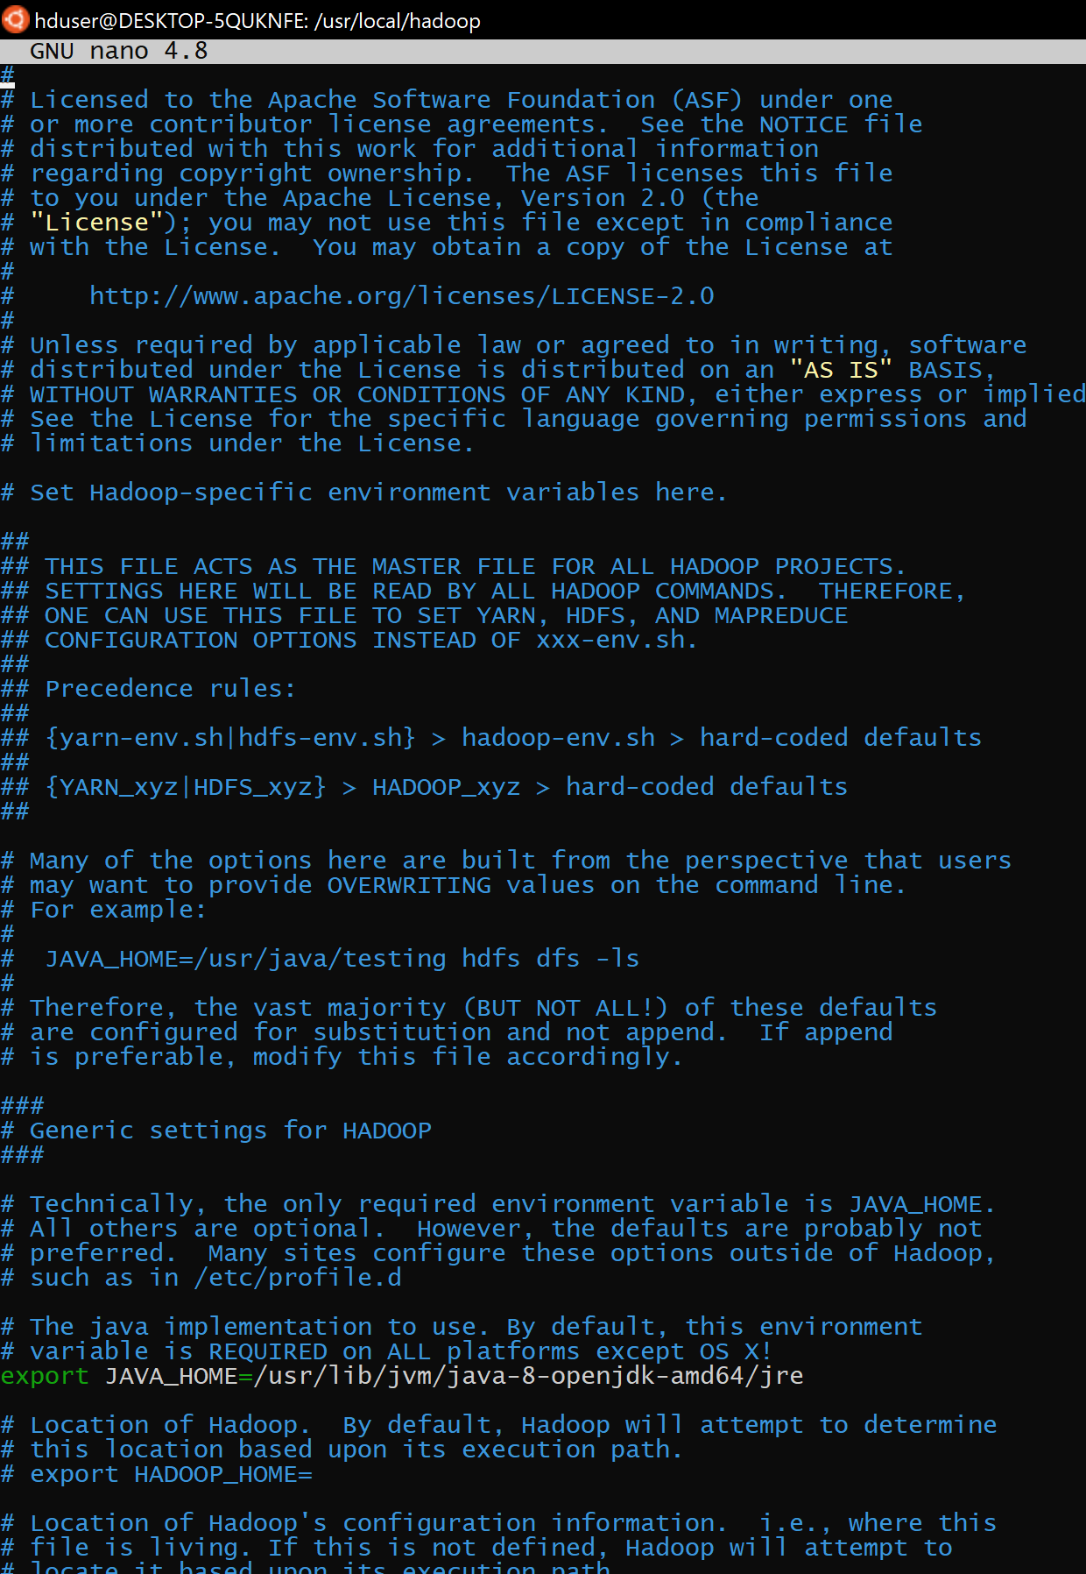
Configuring Hadoop
Assuming you’re in /usr/local still, let’s navigate to the hadoop directory: cd hadoop/. From here, we want to edit Hadoop’s environment variables. To do this, run the following command: nano etc/hadoop/hadoop-env.sh.
On the right you’ll see a screenshot of my file. You will have to uncomment the “export JAVA_HOME” file, and set it to the file path you obtained from two slides ago

Slide 14
More configuration...
We’ll have to configure a couple of files here. Let’s cd etc/hadoop because all the files to edit for our configuration are in here. First up is core-site.xml: nano core-site.xml. Between the open and closing <configuration>...</configuration> tags, paste the following:
<property>
<name>fs.default.name</name>
<value>hdfs://localhost:54310</value>
</property>

Slide 15
Almost there...
In-between the configuration tags of mapred-site.xml (nano mapred-site.xml), paste and save the following:
<property>
<name>mapred.job.tracker</name>
<value>localhost:54311</value>
</property>

Slide 16
Last (but not least)
Do similarly for hdfs-site.xml:
<property>
<name>dfs.replication</name>
<value>1</value>
</property>

Slide 17
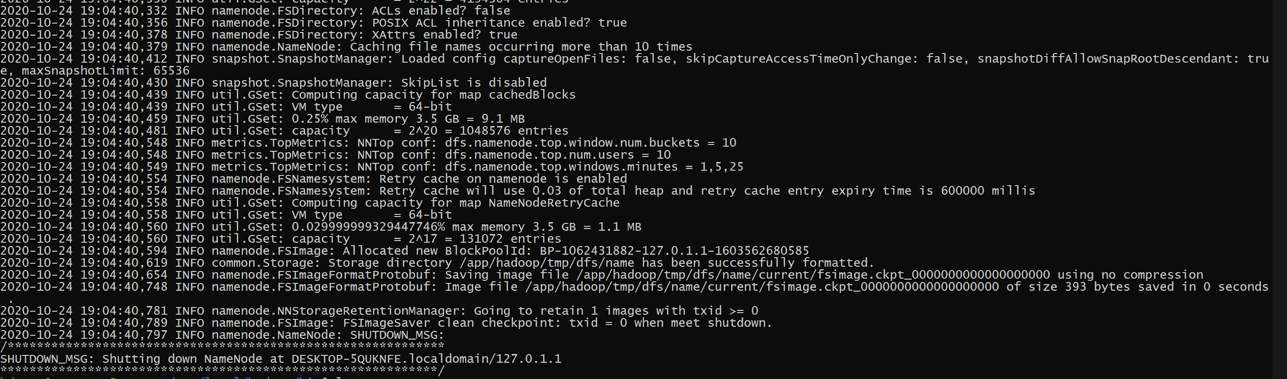
Initialising Hadoop
To use our Hadoop cluster for the first time, we need to format it. Navigate a couple directories up to the root hadoop dir (cd ../../). Validate the path/directory that you’re in is /usr/local/hadoop. If/when that’s the case, run the following: bin/hadoop namenode -format. You’ll see a lot of lines in the output, but you’re looking for the following two lines (which will be near the end of the output). If you DON’T see lines similar to this, then let me know.

Slide 18
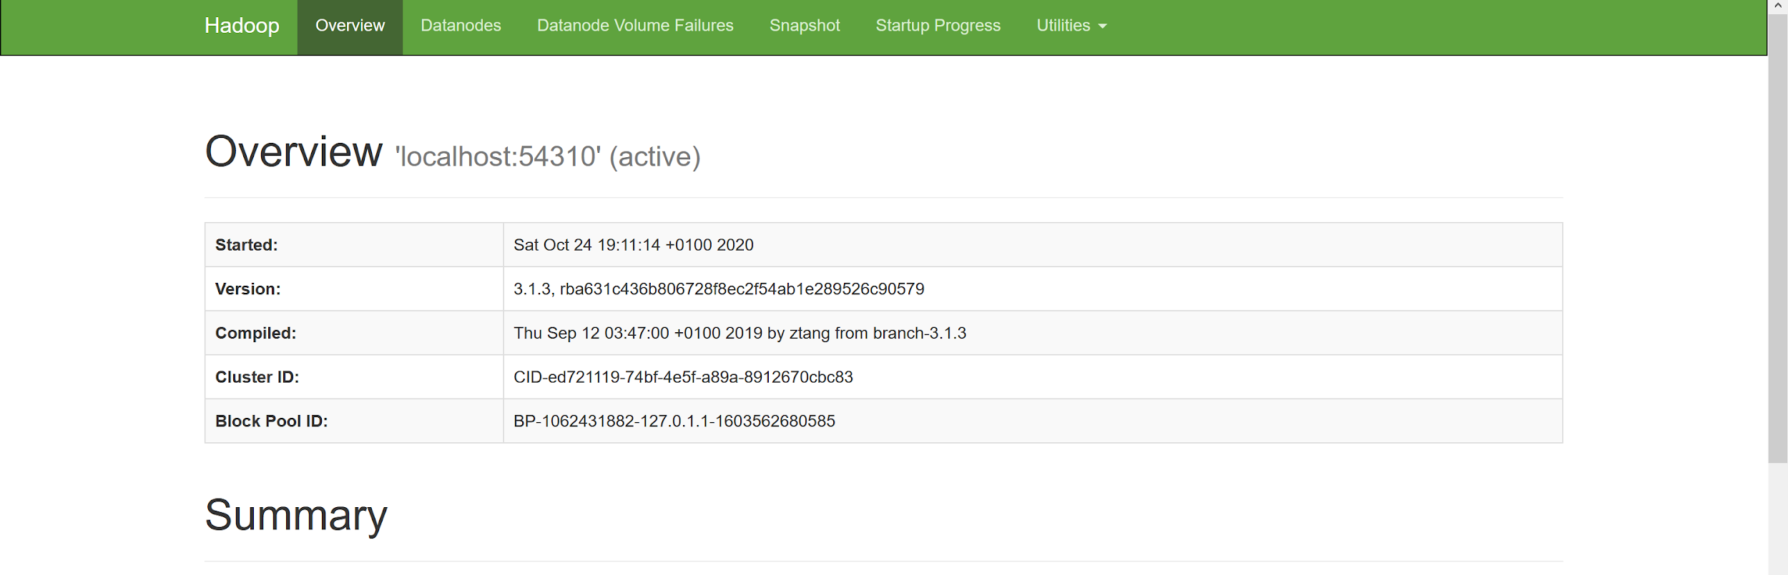
We’re almost done...
Let’s start our first Hadoop cluster: sbin/start-all.sh. We can verify whether the cluster has started by visiting the following page in our browser: http://localhost:9870/. If you something like the following, that’s a good sign:

Slide 19
Testing our installation works (preparation)
We start by making some required directories:
hdfs dfs -mkdir /user
hdfs dfs -mkdir /user/[username] (Obviously replace [username] with your username)
And we also need to download some files to test our installation. We’ll be running a wordcount MapReduce over some Gutenberg books (we’ll cover all of what this means in the lesson - this is just testing our installation!):
mkdir ~/gutenberg
sudo curl http://www.gutenberg.org/cache/epub/20417/pg20417.txt -o ~/gutenberg/20417.txt
sudo curl http://www.gutenberg.org/files/5000/5000-8.txt -o ~/gutenberg/5000-8.txt
sudo curl http://www.gutenberg.org/files/4300/4300-0.txt -o ~/gutenberg/4300-0.txt

Slide 20
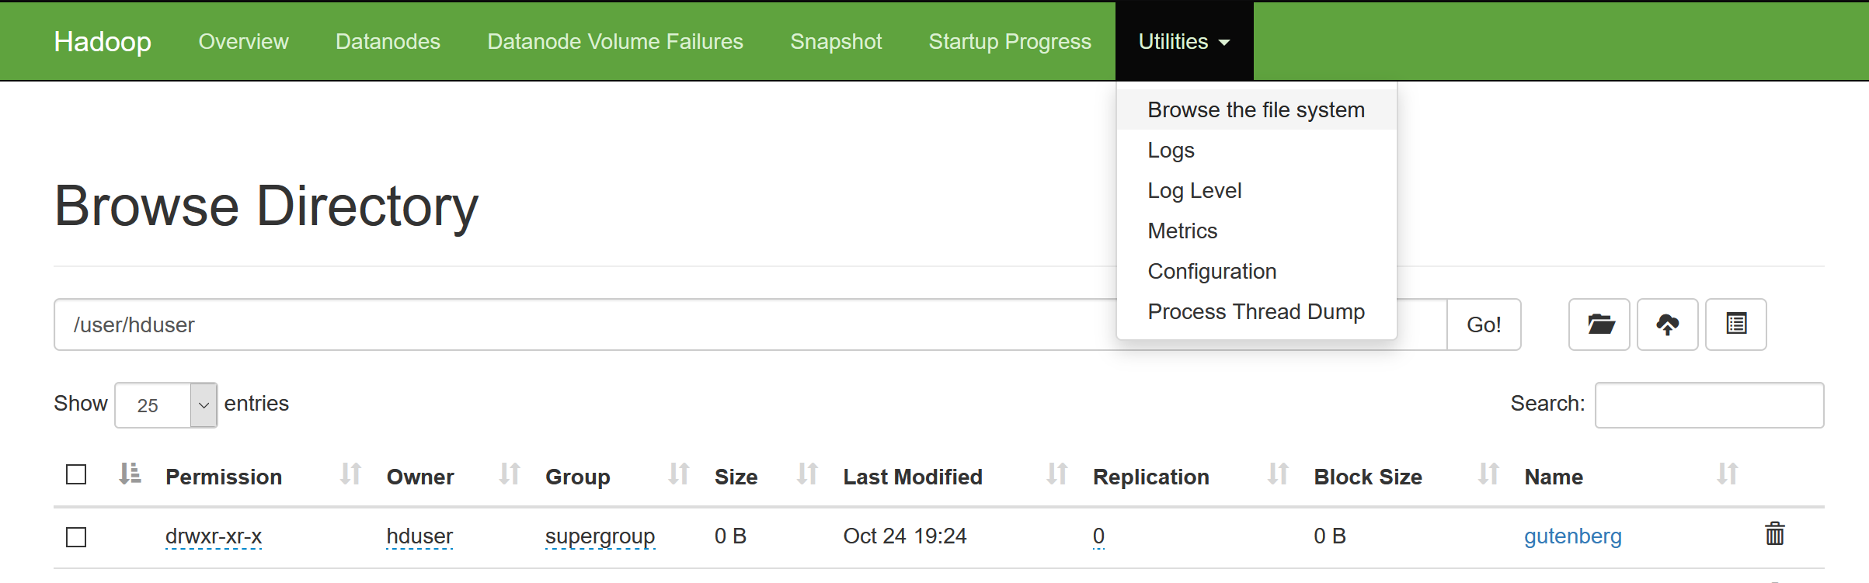
Testing our installation works (last bit of prep!)
Before we run the command to test our installation, we need to copy the files over to the Hadoop file-system: hdfs dfs -put ~/gutenberg/ gutenberg. This will create an gutenberg/ folder in the user we created in the last step. We can validate this is the case by using the file directory in the web interface (in that localhost page, click on Utilities → “Browse the file system”). On the far right column of the table you see, click on “user” under “name”, and then your username. You should see a folder there called “gutenberg”.

Slide 21
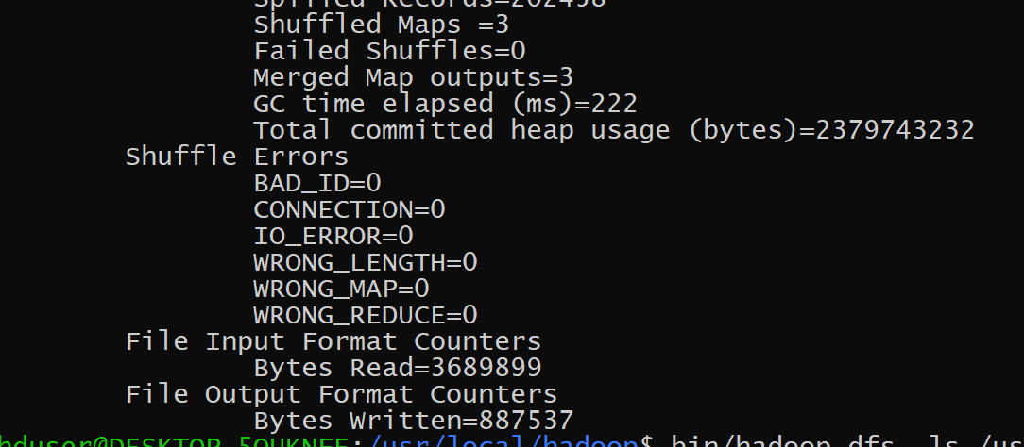
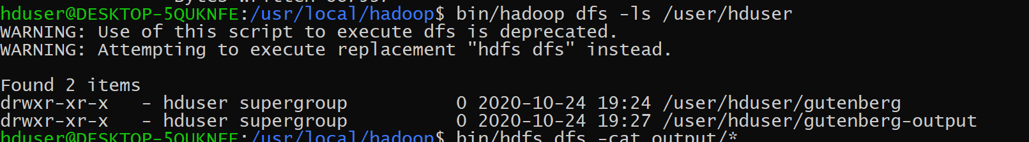
Testing our installation works (actually!!)
Now, all we gotta do is run the wordcount example. Ensuring you’re in the hadoop directory (/usr/local/hadoop), run: hadoop jar share/hadoop/mapreduce/hadoop-mapreduce-examples-3.1.3.jar wordcount /user/[username]/gutenberg /user/[username]/gutenberg-output (Make sure you replace [username]!)
Running this will create a large output which should finish with something like in the screenshot below:
Let’s validate that this task ran successfully: hdfs dfs -ls /user/[username]. You should see two folders there (gutenberg and gutenberg-output)!

Slide 22
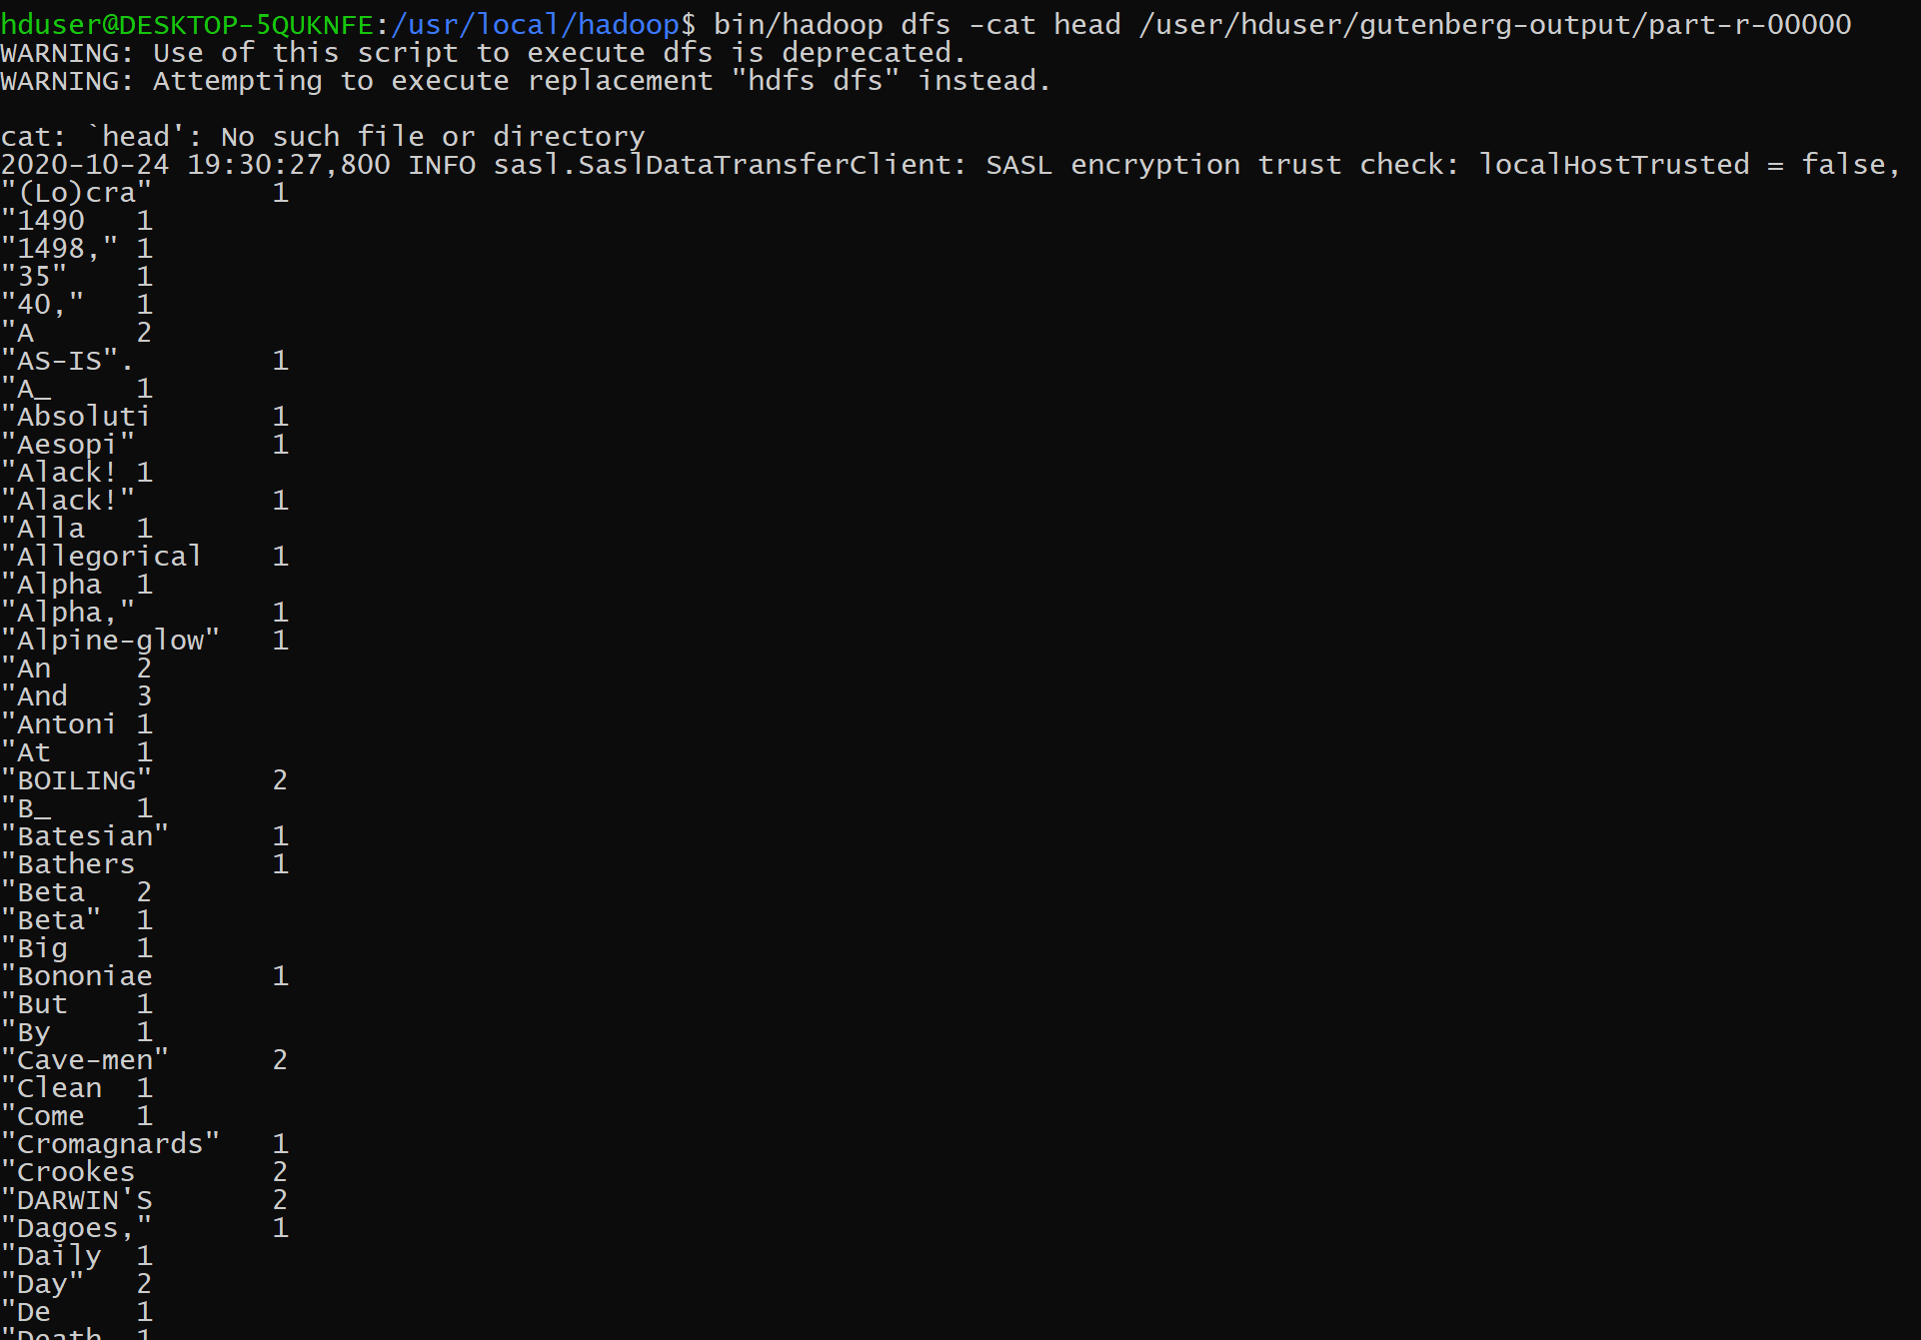
Inspecting the output (Last slide I promise!)
We just ran a task which took in a bunch of books, and counted the frequency of words in each of the books. In the lesson, we’ll dive into how Hadoop does this, but to view the output, simply run what’s following. You might want to press CTRL+C to stop the execution after a second otherwise you’ll be staring at your terminal for a long while ;).
hadoop dfs -cat /user/[username]/gutenberg-output/part-r-00000 (I hope I don’t need to warn you about [username] anymore)

Slide 23

Done!
Congratulations! It may be hard to believe, but you’re finally done! Finished!

